Slide 1
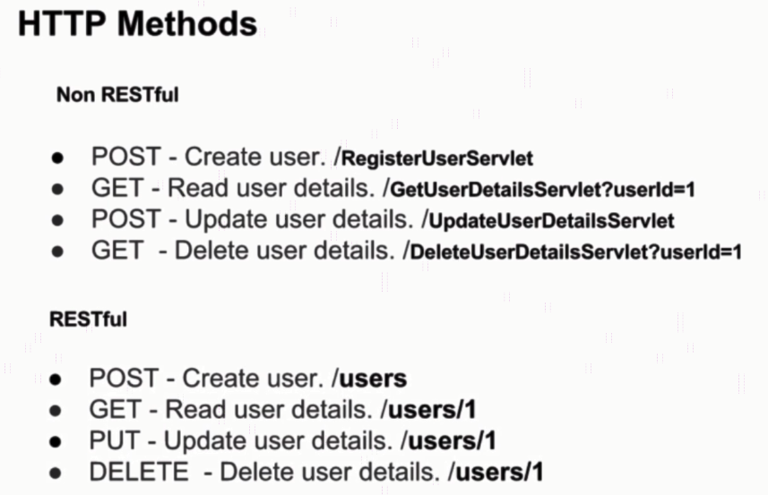
HTTP Methods

Slide 2
Postman Overview
https://www.udemy.com/course/restful-web-services-with-spring-framework-a-quick-start/learn/lecture/11769764#overview

